Slide 1
Environmental Sustainability in East Asia
Policies and Technological Output
Matthew Shapiro
Illinois Institute of Technology
matthew.shapiro@iit.edu

Slide 2
Overview
Focus: Environmental policies & technological output in East Asia
GHG focus
China: place and function
Method: Comparative analysis
Domestic policies and S&T output
Conclusions
Strong efforts in all four countries, overall
Disconnect in China
GHG-centered, not greenhouse effect-centered
Gross concerns for acid rain and domestic infrastructure
* Need for a more robust regional approach *

Slide 3
Background
Post-war era → sustainable economic growth
Industrial & international economic policies
Mid-80s to early 21st century → S&T output
Nelson-Phelps pattern of catch-up
2000 to the present → GHGs/climate change
Omitted from analyses of East Asian NIS
Worldwide effort to address GHG emissions
Global Green New Deal, UN (2008)
Regional efforts to coordinate
Extension of Pempel’s (2006) regionalism

Slide 4
Theory
Key assumptions
International efforts positively correlated with domestic policies
Distinctions between treaties (Schneider, et al., 2008) and TOAs (De Coninck, et al., 2008)
Combination of short-, medium-, long-term goals
Economic growth a function of national innovative capacity
Hypothesis
A positive connection exists between policies and related research output
Non-uniform impact of domestic, regional, and international policies

Slide 5
Method
Correlate relevant policies over the post-war era…
International
Regional
Domestic
… with GHG-related S&T output in East Asia
GHG patent output (USPTO)
GHG publications output (ISI-Web of Science)
* “greenhouse effect” and/or “greenhouse gas”

Slide 6
International coordination
1965 UNDP
1972 UNEP (Stockholm Conference)
1979 Convention on Long Range Transboundary Air Pollution
1987 Montreal Protocol
1992 UN Commission on Sustainable Development
2002 Johannesburg World Summit on Sustainable Development
Present → H. Clinton’s action plan for S&T efforts: “Knowledge will not flow freely to developing world.”

Slide 7
Regional coordination
The Clean Development Mechanism (CDM)
China: 1,682 projects (36% of all CDM projects)
239 originate from Japan
Taiwan: zero
Evidence of political and institutional constraints to regional environmental policy coordination in NE Asia (Nam 2002)
Accounting for S&T efforts and supra-regional GHG targets
Technology-oriented agreements (TOA) a more successful option (De Coninck, et al., 2008)
Asia Pacific Partnership on Clean Development and Climate (APPCDC)

Slide 8
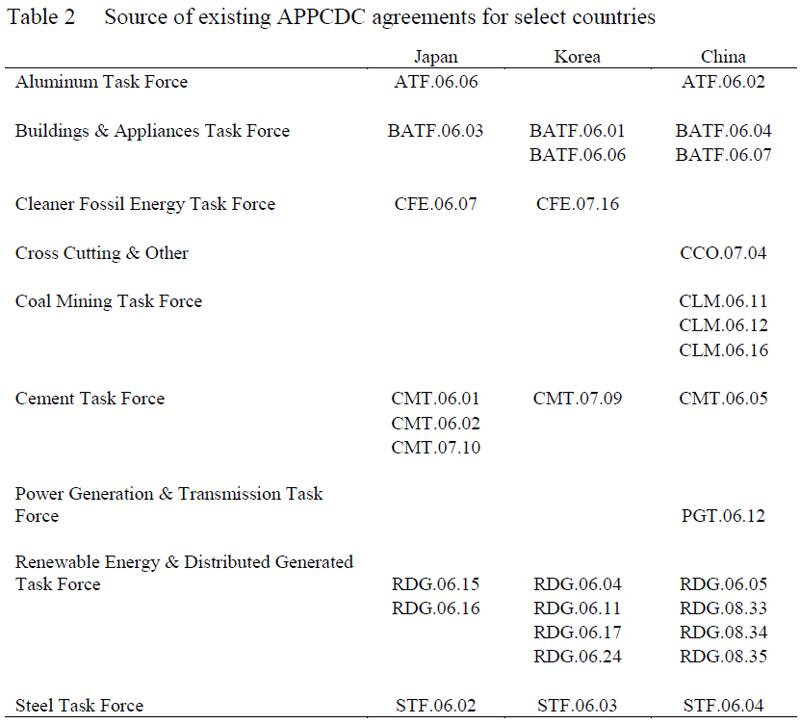

Slide 9
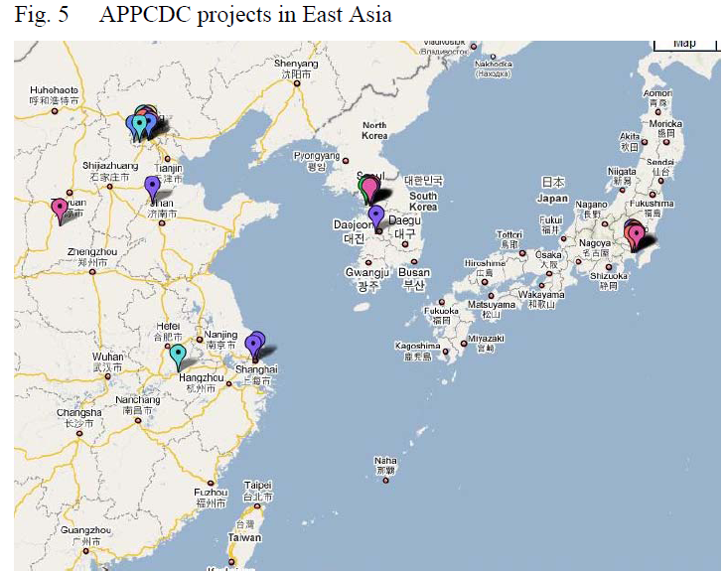

Slide 10
Domestic efforts
Air pollution emphasis
Japan
Law Concerning the Promotion of the Measures to Cope with Global Warming
Taiwan
Basic Environment Act
Air Pollution Control Act
Korea
Clean Air Conservation Act
China
National Eleventh Five-Year Plan for Environmental Protection
Law of the People’s Republic of China on the Prevention and Control of Atmospheric Pollution in China

Slide 11
Domestic efforts
Air pollution emphasis – S&T correlation
Japan
Third Basic Plan (2006-2010),
Taiwan
Agenda 21 and Basic Environment Act of 2002, establishment of Taiwan Industrial Greenhouse Office (TIGO) in 2006
Korea
$23 billion over the next five years
China
Energy efficiency and environmental preservation; no effort to mitigate or address GHGs

Slide 12
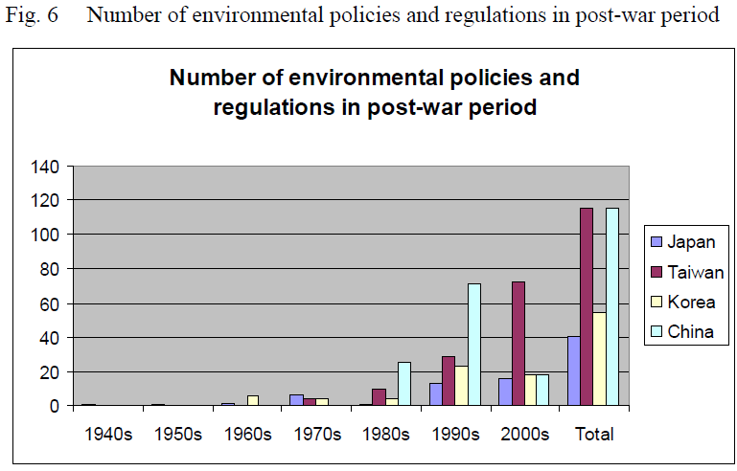

Slide 13
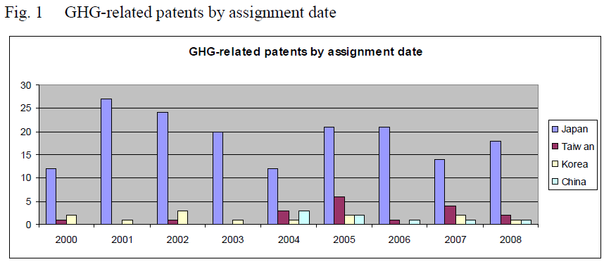

Slide 14
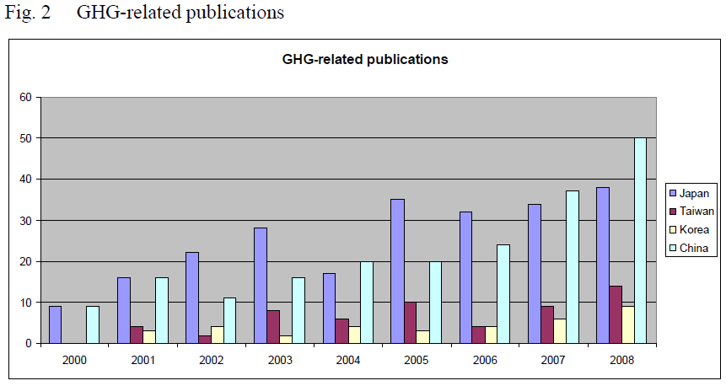

Slide 15
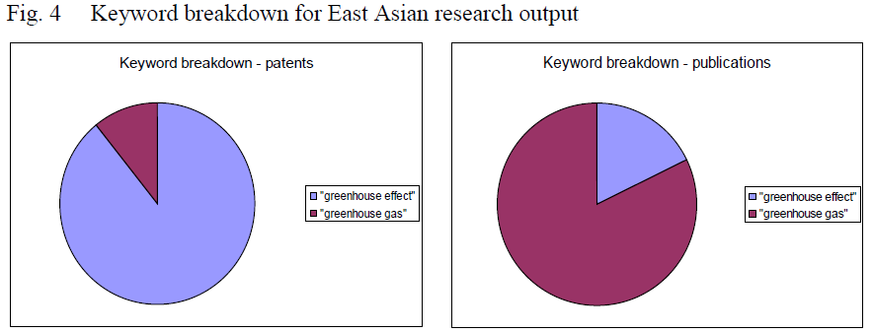

Slide 16
Implications
Replicability of the East Asian case
A variant of an existing theme
World Bank (1993), Evans (1998)
Growth in a sustainable fashion
Focus 1 → acid rain
Focus 2 → overarching: greenhouse effect
Expansion of catch-up model
Growth through efforts at sustainability
Region-centered TOAs have substantial positive externalities
Greater potential to impact China’s domestic policies

